Slide 1
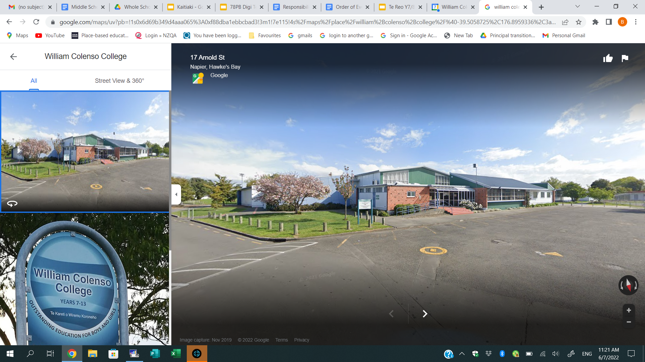

Annual Plan 2025 - Step Up and Raise the Bar
1) Giving Practical Effect and mana to te Tiriti O Waitangi
Develop respectful, positive, supportive and productive relationships through nurturing strong school values.
Focus on improving, growing and advancing educational aspirations, achievements and success.

Slide 2
Annual Plan 2025 - Step Up and Raise the Bar
2) School Values
Manaakitanga (Respect)
Whanaungatanga (Belonging)
Hirangatanga (Striving for Excellence)

Slide 3
Annual Plan 2025 - Step Up and Raise the Bar
3) Culturally Responsive and Relational Pedagogy
Build strong relationships with students and whanau
Provide learning contexts that raise student engagement
Enable Shared learning
Remove Barriers
Reduce Inequalities

Slide 4
Annual Plan 2025 - Step Up and Raise the Bar
4) Whanau + Iwi Engagement
Work with family and whānau to encourage learners to realise aspirations.
Continue to enhance Mana Whenua links to create improved outcomes for students and whanau.

Slide 5
Annual Plan 2025 - Step Up and Raise the Bar
5) Pastoral - Role of Deans
- Change to year level deans in 2025
- Provide consistency to year levels
- Specialisation of year levels
-Monitor of academic Progress
- Learning Pathways
- Home school partnership.
Pastoral - Role of Form Teacher
- change to form teacher role in 2025 from house to year level.
– Re imagine the role of the form teacher
- Oversight for pastoral cares, behaviour, academic
- Home Contact as required,
- Encourage Manaakitanga, Whanaungatanga and Hirangatanga

Slide 6
Annual Plan 2025 - Step Up and Raise the Bar
6) Attendance
Improve attendance data. by having high aspirations for every learner.
- Change to pastoral system to focus on and assist with monitoring attendance
Home Liaison
Early intervention (home contact)

Slide 7
Annual Plan 2025 - Step Up and Raise the Bar
7) NCEA L1 FOCUS
Build capacity around New Standards
Encourage students to prepare and sit externals assessments
Support around Lit / Num CAAs

Slide 8
Annual Plan 2025 - Step Up and Raise the Bar
8) Overall Data, Targets & Achievement
Collect, Collate and Analyse Data (Y7&8 e ASttle Data, Y9&Y10 Data, L1, L2 & L3 NCEA Data , Lit / Num Data
Use student achievement data to inform teaching and learning programmes.

Slide 9
Annual Plan 2025- Step Up and Raise the Bar
9) Co - construction Y9&Y10
2 x Term Co construction hui for all y9 & y10 teachers
Opportunity for collaboration between teachers.
Provide a process which allows for a shared understanding of students, problem solving, and learning.

Slide 10
Annual Plan 2025 - Step Up and Raise the Bar
10) Positive Behaviour, HIgh Expectations and Consistency
Use school values, school assembly, form classes and classrooms to promote and encourage positive behaviour, high expectations, and consistency.
Encourage students to be school ready
Step up and Raise the bar.

